Slide 1
data ANALYTICS
Dr.E.Sivasankar, NIT,Tiruchirappalli-15

Slide 2
Data Analytics
Data analytics (DA) is the science of examining raw data with the purpose of drawing conclusions about that information.
Data analytics is used in many industries to allow companies and organization to make better business decisions
In the science it is used to verify or disprove existing models or theories.

Slide 3
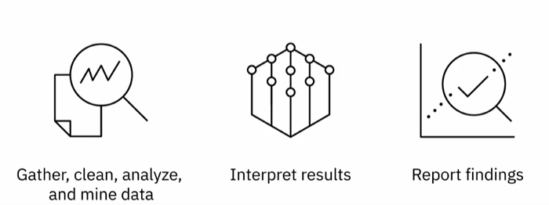
Data Analysis
Data analysis is the process of gathering, cleaning, analyzing, and mining data, interpreting results and reporting the findings.
With data analysis, we find patterns within data and correlations between different data points.
And it is through these patterns and correlations that insights are generated, and conclusions are drawn.

Slide 4
Data Analysis
Data analysis helps businesses understand their past performance and informs their decision-making for future actions.
Using data analysis, businesses can validate a course of action before committing to it.
Saving valuable time and resources and also ensuring greater success.

Slide 5
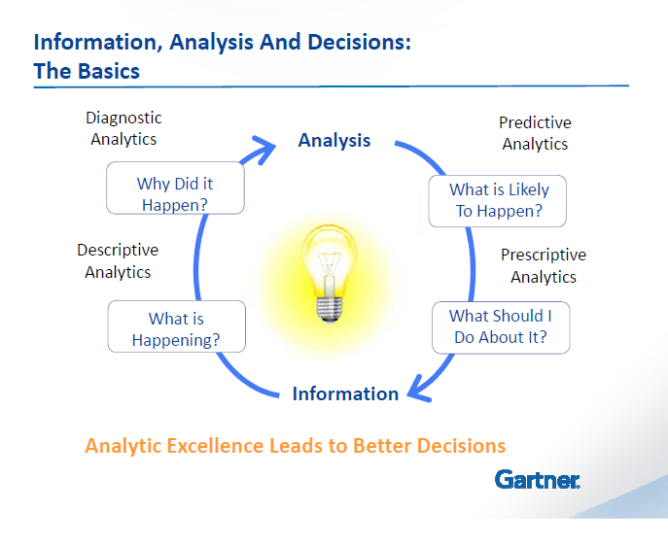

Slide 6
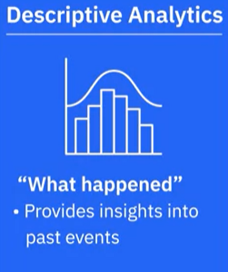
Descriptive Analytics
Descriptive Analytics helps answer questions about what happened over a given period of time by summarizing past data and presenting the findings to stakeholders.
It helps provide essential insights into past events.
For example, tracking past performance based on the organization’s key performance indicators or cash flow analysis.

Slide 7
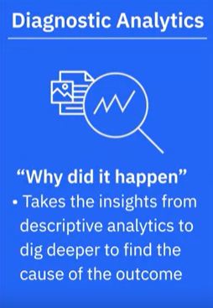
Diagnostic Analytics
Diagnostic analytics helps answer the question, Why did it happen?
It takes the insights from descriptive analytics to dig deeper to find the cause of the outcome.
For example, a sudden change in traffic to a website without an obvious cause or an increase in sales in a region where there has been no change in marketing.

Slide 8
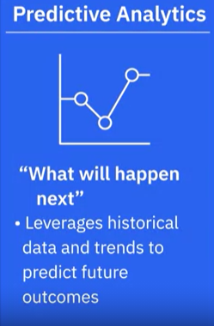
Predictive Analytics
Predictive analytics helps answer the question, What will happen next? Historical data and trends are used to predict future outcomes.
Some of the areas in which businesses apply predictive analysis are risk assessment and sales forecasts.
It’s important to note that the purpose of predictive analytics is not to say what will happen in the future, its objective is to forecast what might happen in the future. All predictions are probabilistic in nature.

Slide 9
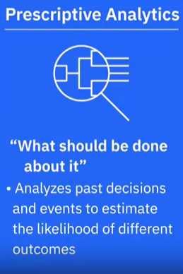
Prescriptive Analytics
Prescriptive Analytics helps answer the question, What should be done about it? By analyzing past decisions and events, the likelihood of different outcomes is estimated on the basis of which a course of action is decided.
Self-driving cars are a good example of Prescriptive Analytics. They analyze the environment to make decisions regarding speed, changing lanes, which route to take, etc.
Airlines automatically adjusting ticket prices based on customer demand. Gas prices, the weather, or traffic on connecting routes.

Slide 10
Classification
Classification maps data into predefined groups or classes.
It is often referred to as supervised learning, because the classes are determined before examining the data.
It may be represented by methods such as decision trees, mathematical formulae, if then rules and Neural Networks.

Slide 11
Regression
Regression is used to map a data item to a real valued prediction variable.
Regression assumed that the target data fixed into some known types of functions (Example - Linear, logistic).

Slide 12
Example:
A manager wants to reach a certain level of savings before his retirement.
Periodically he predicts his retirement savings by current value and several past values.
He uses a simple linear regressive formula to predict the values of savings in future.

Slide 13
Time series analysis
Here the value of an attribute is examined as it varies over a period of time.
The values are usually obtained as evenly spaced points-daily, weekly, monthly and so on.
Applications :
The structure of the series is used to determine the behavior of a product.

Slide 14
Example :
A person wants to determine the purchase of stock from three different companies x, y or z.
For a period of one month, he charts the daily stock price for each company.
He decides to purchase stock x, because it is less volatile and it shows a large amount of growth compared to the other stocks.

Slide 15
Prediction
Many real world applications can be seen predicting future data states based on past and current data.
Prediction can be viewed as a type of classification.
The difference is that prediction is predicting a future state than a current state.

Slide 16
Example
Predicting flooding is a difficult problem one approach uses monitors placed at various points in the river.
These monitors collect data relevant to flood prediction namely water level, rain amount, time, humidity and so on.
Then the water level at potential flooding points in the river can be predicted based on the data collected by the sensors

Slide 17
Descriptive Data Analytics
Clustering
Clustering is similar to classification except that the groups are not
predefined.
Clustering is alternatively referred to as unsupervised learning or segmentation.
The objects are clustered based on the principle of maximizing the intra-class similarity and minimizing the inter-class similarity.

Slide 18
Association Rule
Association refers to the data mining task of uncovering relationship among data.
An association rule is a model that identifies specific types of data associations.
These associations are often used in retail sales community to identify the items (products) that are frequently purchased together.

Slide 19
Sequence Discovery
Sequential analysis or sequence discovery is used to determine sequential patterns in data.
These patterns are based on a time sequence of actions.
Unlike association analysis, which requires products to be purchased at a same time, in sequence discovery, the items are purchased over a period of time in some order.
For example, most people who purchase Computers may be found to purchase Internet connection within one week. All temporal association rules fall into this category.

Slide 20
Data Characterization
It is a summarization of the general characteristics or features of target class of data.
The output of data characterization can be presented in various forms namely pie charts, bar charts, curves and multi-dimensional data cubes.

Slide 21
Data Discrimination
Data discrimination is a comparison of the general features of target class of data objects with the general features of objects from one or a set of contrasting classes.
The target and contrasting classes can be specified by the user and the corresponding data objects retrieved through database queries.
For example, the user may like to compare the general features of software products whose sales increase by 10% in the last year with those sales decreased by 30% during the same period.

Slide 22
Outlier Analysis
A database may contain data objects that do not comply with the general behavior model of the data.
These data objects are called as outliers.
Most data mining methods discard outliers as noise or exceptions.
However, in some applications such as fraud detection, the rare events may be more interesting than regularly occurring events.
The analysis of outlier data is referred to as outlier mining.

Slide 23
Data Engineers
Data Engineers work within the data ecosystem to extract, integrate, and organize data from disparate sources, clean transform and prepare data design, store and manage data in the data repositories.
They enable data to be accessible in formats and systems that the various business applications, as well as stakeholders like data analysts and data scientists, can utilize.

Slide 24
Data Analyst
In short, a data analyst translates data and numbers into plain language, so organizations can make decisions, data analysts inspect and clean data for deriving insights, identify correlations, find patterns, and apply statistical methods to analyze and mine data and visualize data to interpret and present the findings of data analysis.

Slide 25
Data Scientists
Data scientists analyze data for actionable insights and build a machine learning or deep learning models that train on past data to create predictive models.
Data scientists are people who answer questions such as, How many new social media followers am I likely to get next month, or what percentage of my customers am I likely to lose to competition in the next quarter

Slide 26
Business Analysts
Business analysts leverage the work of data analysts and data scientists to look at possible implications for their business and the actions they need to take or recommend.
Their focus is on the market forces and external influences that shape their business.
They provide business intelligent solutions by organizing and monitoring data on different business functions and exploring that data to extract insights and actionable that improve business performance.

Slide 27
Business Analysts
Business analysts leverage the work of data analysts and data scientists to look at possible implications for their business and the actions they need to take or recommend.
Their focus is on the market forces and external influences that shape their business.
They provide business intelligent solutions by organizing and monitoring data on different business functions and exploring that data to extract insights and actionable that improve business performance.

Slide 28
Business Analysts
To summarize, in simple terms, data engineering converts raw data
into usable data.
Data analytics uses this data to generate insights.
Data scientists use data analytics and data engineering to predict the
future using data from the past.
Business analysts and business intelligence analysts use these insights
and predictions to drive decisions that benefit and grow their business

Slide 29
Advanced Databases
Database
Database is a collection of related data.
DBMS
DBMS is a software that is used to define, construct and manipulate a database.
Relational Databases
A relational database is a collection of tables and each table is assigned, a unique table name. Each table consists of a set of attributes (columns or fields) and usually stores a large set of tables (records or rows). More each table is identified by a unique key. An entity relationship (ER) model, models the database as a set of entities and a set of relationship.

Slide 30
Advanced Databases
Data warehouse
A data warehouse is repository of information collected from multiple sources, stored under an unified schema and which usually resides at a single site.
Data warehouses are constructed through the process of data cleaning, data transformation, data integration, data loading and periodic data refreshing.
It provides multidimensional view of data and allows the pre computation and fast accessing of the summarized data.

Slide 31
Advanced Databases
Differences between data mart and data warehouse
A data warehouse collects information about subjects that span an entire organization. Its scope is enterprise wide.
A data mart is department subset of a data warehouse. It focuses on selected subjects and its scope is department wide.
Transactional Databases
It consists of a file where each record represents a transaction. A transaction typically includes a unique transaction identity number (trans_id) and a list of items making up the transaction (such as the items purchased in a store.)

Slide 32
Advanced Databases
There are seven types of advanced databases.
Object oriented databases
They are base on the objected oriented programming paradigm. Here each entity is considered as an object. Data and code related to an object are encapsulated into a single unit.
Each object is associated by
1. A set of variables that describe the objects. These correspond to attributes in entity relationship and relational models.

Slide 33
Object oriented databases
2. A set of messages that the object can use to communicate with the other objects or the rest of the database system.
3. A set of methods where each method holds the code to implement the message.
Objects that share a common set of properties can be grouped into a class. Each object is an instance of a class.

Slide 34
Object relational databases
They are constructed based on an object-relational data model.
This model extends the relational model by providing a rich data type for handling complex objects and object orientation.
It has the power to handle complex data types, class hierarchies and object inheritance.

Slide 35
Spatial databases
It contains spatial information.
Such databases include medical and satellite image databases, geographic databases, VLSI chip design databases.
Spatial data my be represented in raster format consisting of n-dimensional bit maps or pixel maps.

Slide 36
Geographical databases have a no. of applications :
1. Forestry and ecological planning
To provide public service information regarding the location of telephone and electronic cables, pipes and sewage system.
3. It is used in vehicle navigation and dispatching system.

Slide 37
Spatial databases contd
Taxi operators could store a city map with information regarding one-way streets, suggested routes for moving from region A to region B during rush hours or peak hours.
The location of hospitals and restaurants as well as the current location of the each driver.
Spatial databases may also be used for town/city planning.

Slide 38
Temporal and time series databases
They store time related data. A temporal database usually stores relational data that includes time related attributes. These attributes may involve several time stamps each having different semantics.
A time series database stores sequence of values that changes with time, such as data collected regarding the stock exchange.
Data mining techniques can be used to find the characteristics of object evolution or the trend of changes for objects in the database or strategy planning.

Slide 39
Text databases
Text databases contain word descriptions for objects. These descriptions may be keywords, long sentences or paragraphs such as product specifications, error or bug reports, summary notes or other documents.
It can uncover content association and clustering behavior of text objects.

Slide 40
Multimedia databases
Multimedia databases store image, audio and video data.
They are used in applications such as content based image retrieval, voice mail systems, video on-demand systems and a speech based user interface that recognizes user’s spoken commands.
Multimedia databases support large objects that can require large volume (GB) of storage. Data must be available continuously without gap during retrieval (Data on-demand)

Slide 41
Heterogeneous Databases
A heterogeneous database combines different kinds of database systems such as relational or object oriented databases, hierarchical databases or network databases.
It consists of a a set of interconnected, autonomous component databases. The components communicate in order to exchange information and answer queries.
Objects in one component database may differ greatly from objects in other component databases.

Slide 42
Legacy Databases
A legacy database is generally something that you will have to inherit and base some of your design decisions around.
A legacy database is a group of heterogeneous databases that may be connected by intra-or inter-computer networks.

